Slide 1
HAPPY HOURS
Movie recommendation system
TEAM NUMBER: 52
RAJNEET KAUR
MANMEET KAUR
NAVNEET KAUR
SIMARJEET KAUR
SMART HACKATHON 2023 - SBSSU
Presented by: team achievers
From gulzar group of institutes, khanna

Slide 2
INTRODUCTION
Happy Hours is a movie recommendation system that is a software application that suggests movie to users based on their preferences and related genres
Goal: A user’s interest is filtered and suggested on the basis of their recommendations
Several approaches are used to build a movie recommendation system
Here, we use content based filtering for similarities in products and content features about the user to make recommendations
Mainly used for entertainment services

Slide 3
DESIGN
Start
Input movie
Combine features
Feature text extraction
Matrices pairwise
Rank list
Output

Slide 4
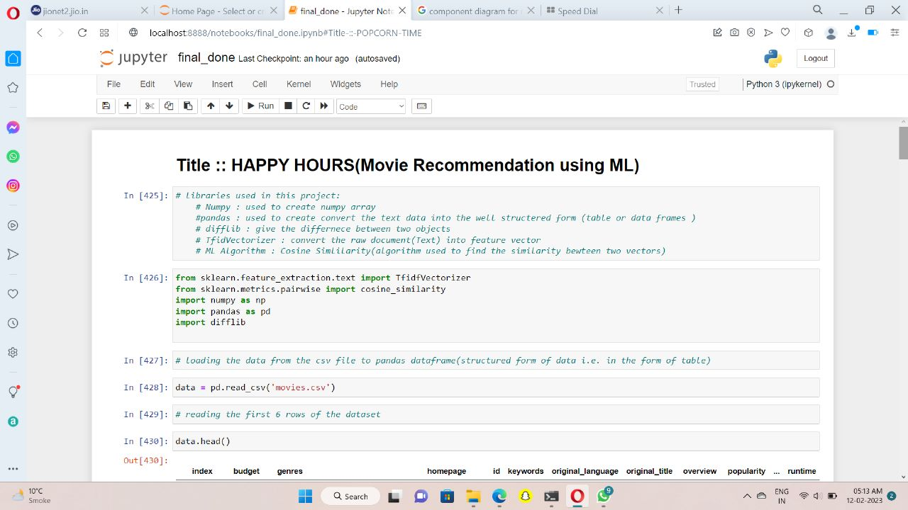
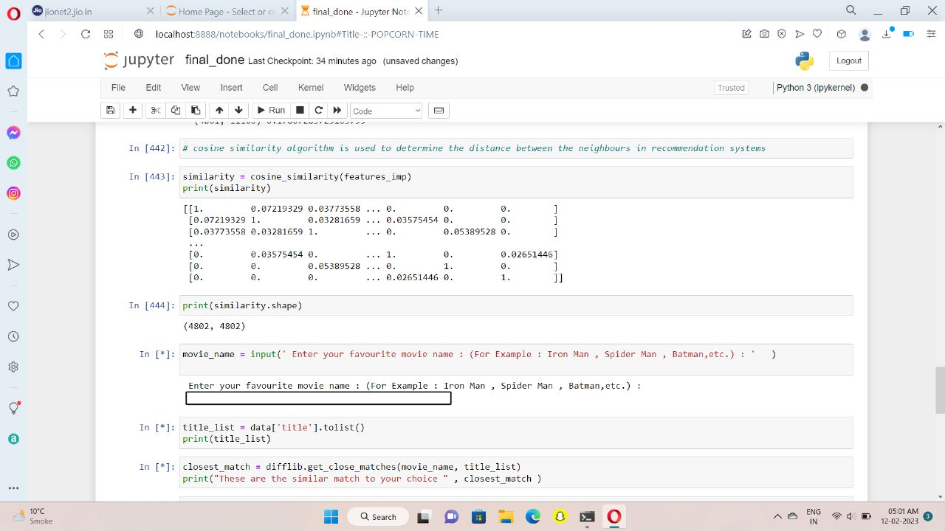
SCREENSHOTS

Slide 5
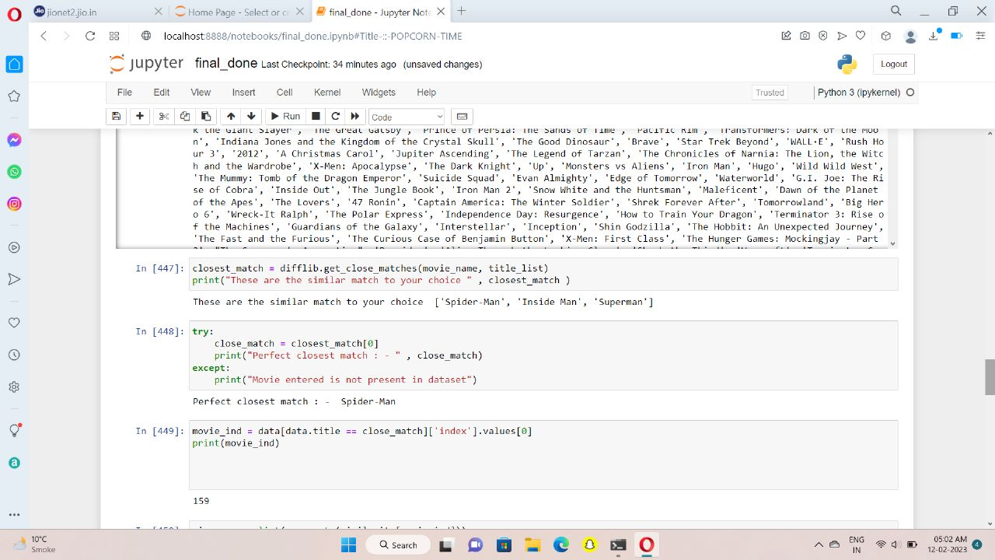
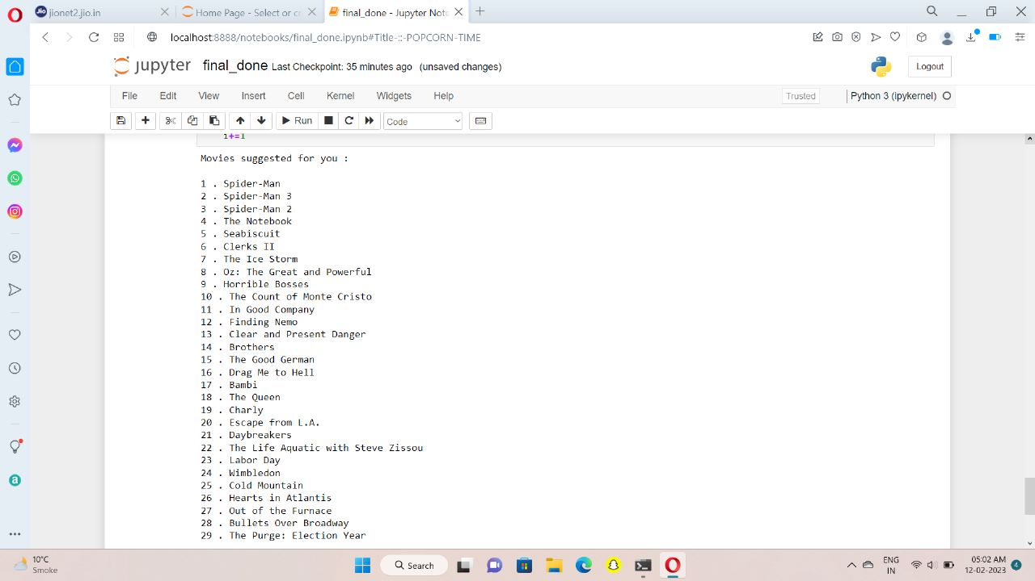
SCREENSHOTS

Slide 6
FUTURE SCOPE
Integration with Streaming Services: It could be integrated with streaming services to provide users with an easier and more convenient way to find and watch movies.
Use of Big Data and Machine Learning: The use of big data and advanced machine learning techniques will allow for more accurate and personalized recommendations to better understand the context and sentiment behind the user's movie preferences.
Integration with Social Media: Integrating this system with social media platforms could allow users to share and discover new movies with friends and other users.
Recommendation Based on Emotion: This could be improved by incorporating emotional analysis which would provide recommendations based on the user's mood and emotions.

